Slide 1
Hosting a Static Website on Amazon S3
Presented by: Chinwuba Chidubem

Slide 2
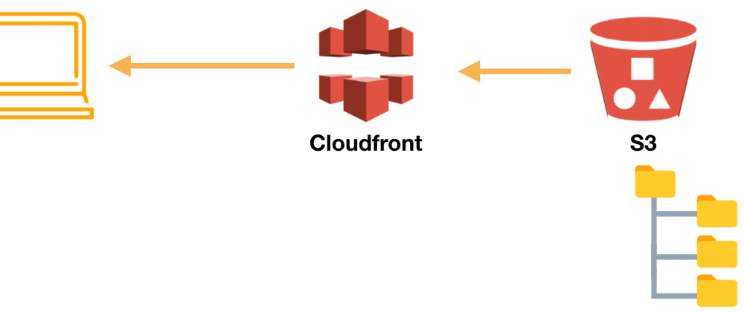
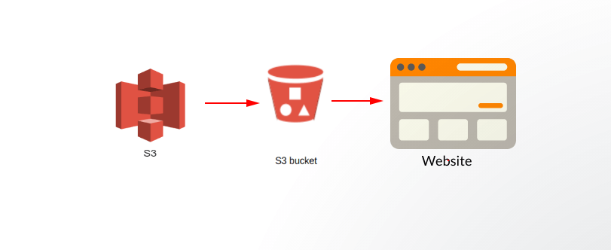
ARCHITECTURE

Slide 3
OUTLINE
CREATE S3 BUCKET
UPLOAD OBJECT IN S3
MODIFY PERMISSIONS
MODIFY BUCKET POLICY
STATIC WEBSITE HOSTING
BUCKET VERSIONING

Slide 4
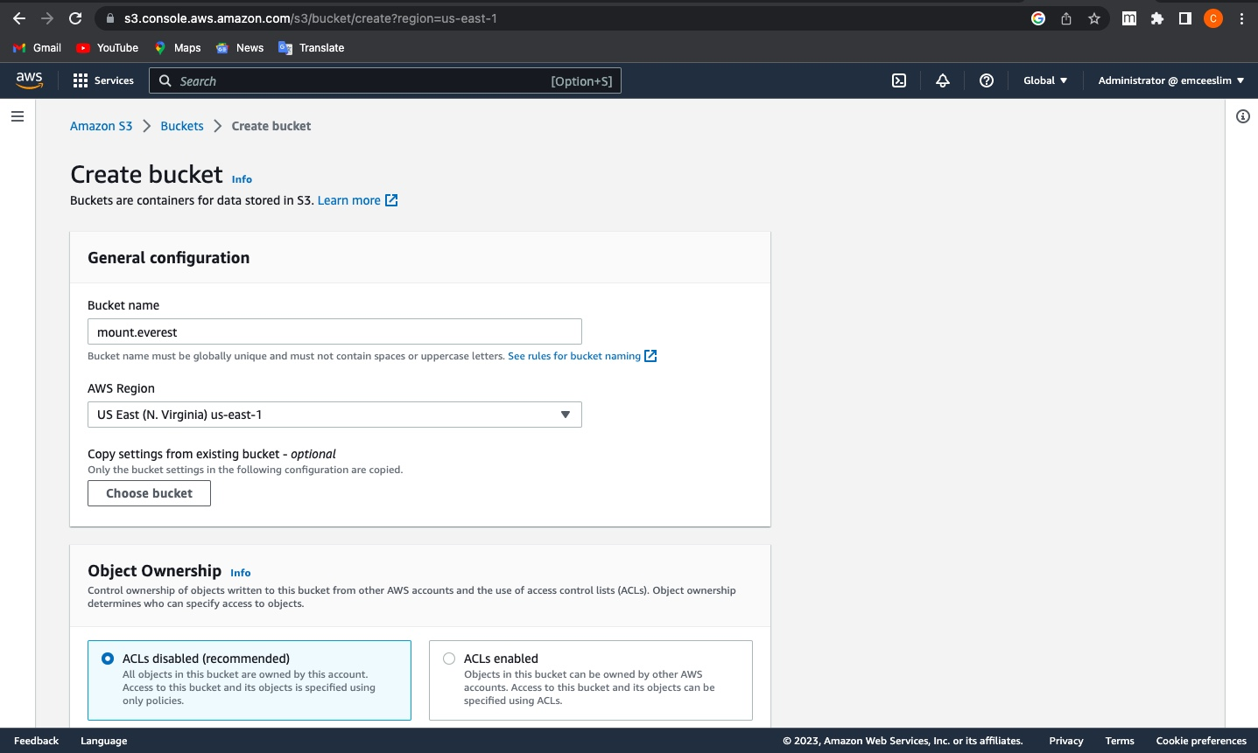
CREATE BUCKET

Slide 5
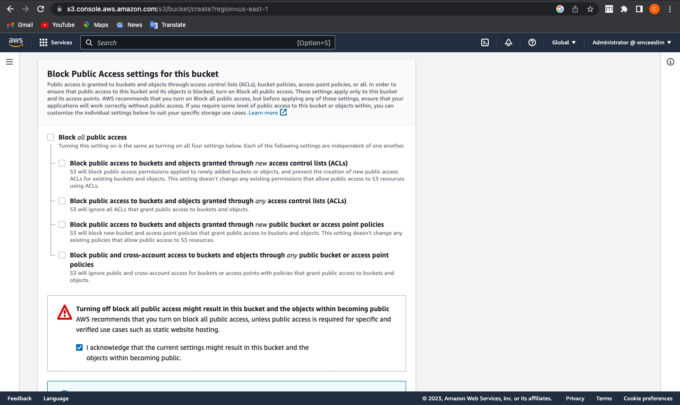
Turn off blocking off public access

Slide 6
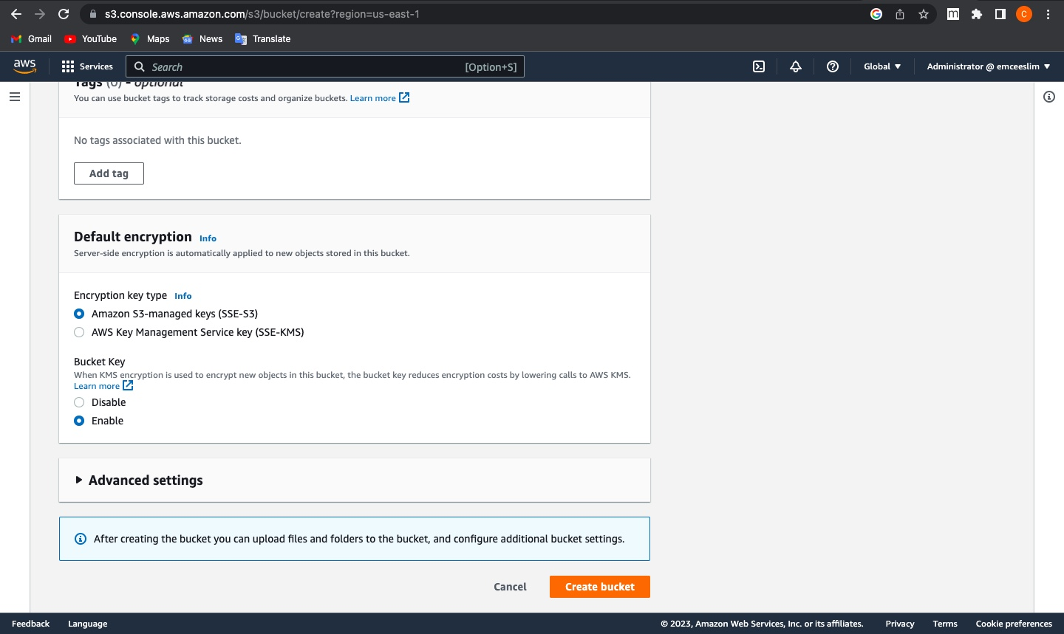
Enable Bucket Versioning

Slide 7
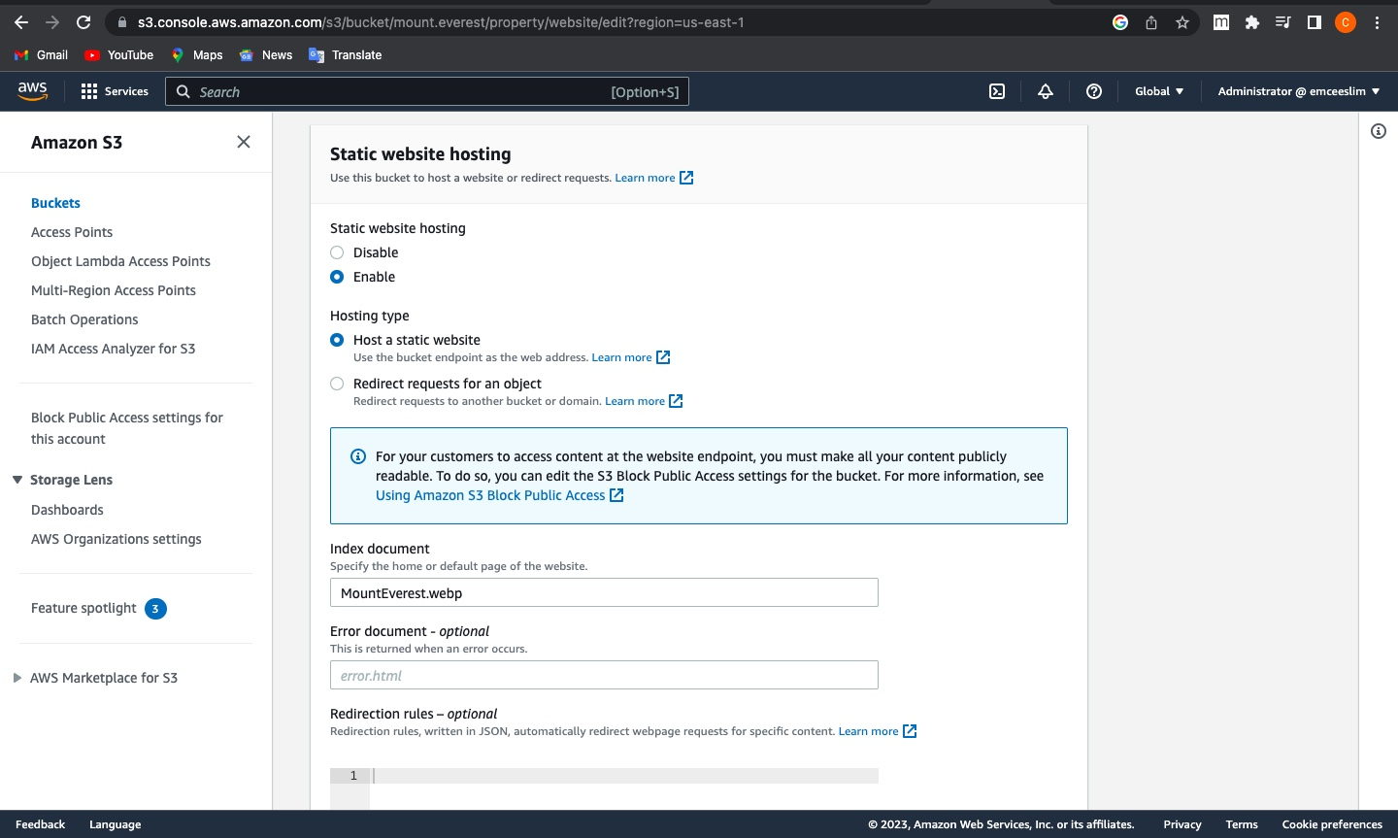
Enable Static Website Hosting

Slide 8
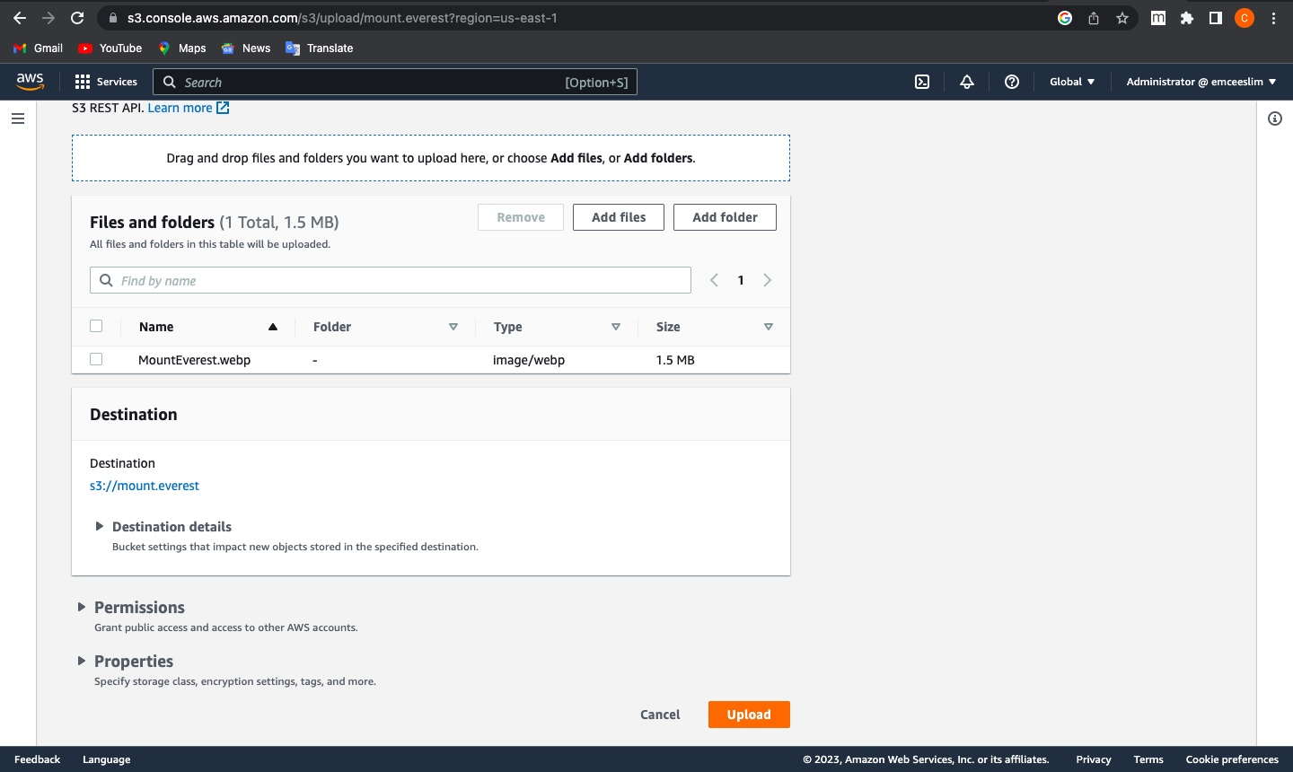
Upload File

Slide 9
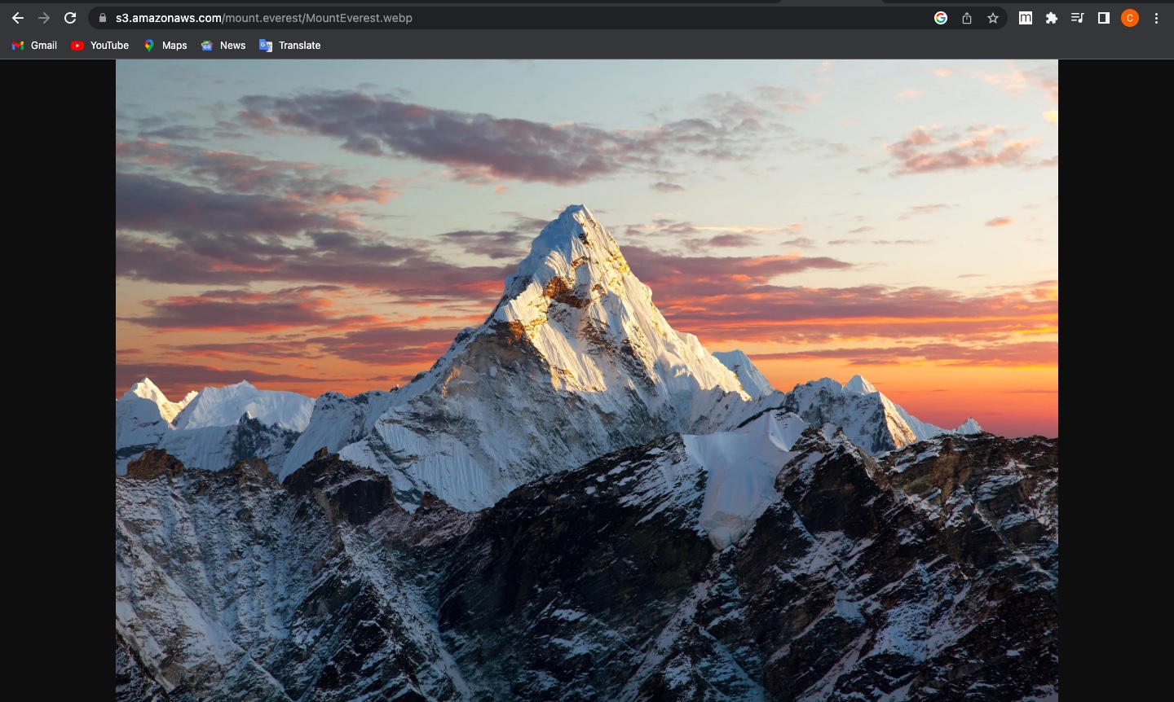
Accessing Website Internally

Slide 10
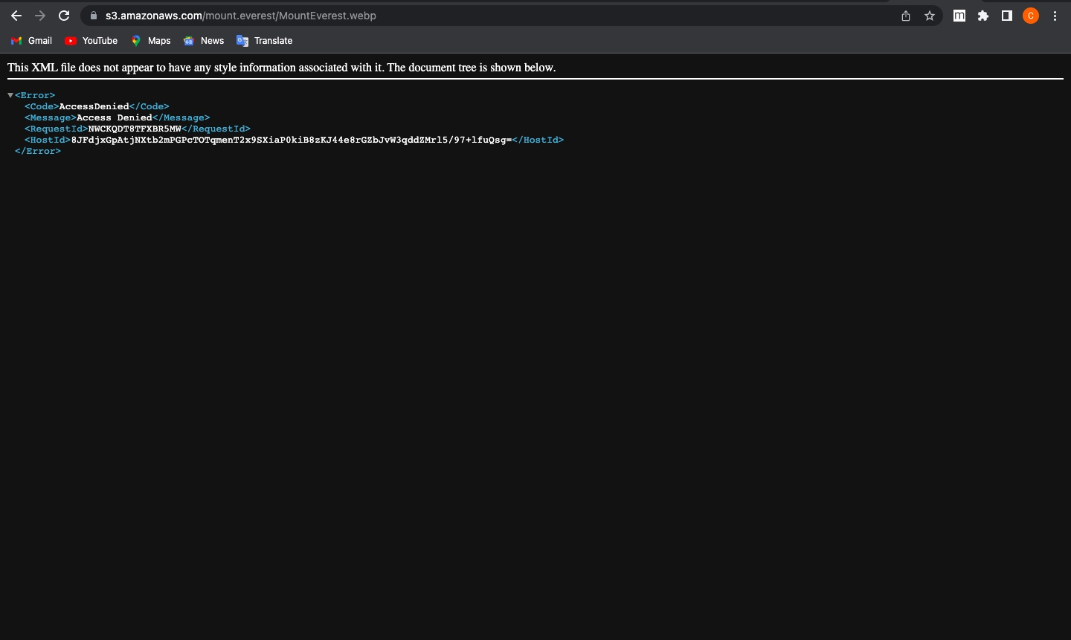
Acessing Website Externally

Slide 11
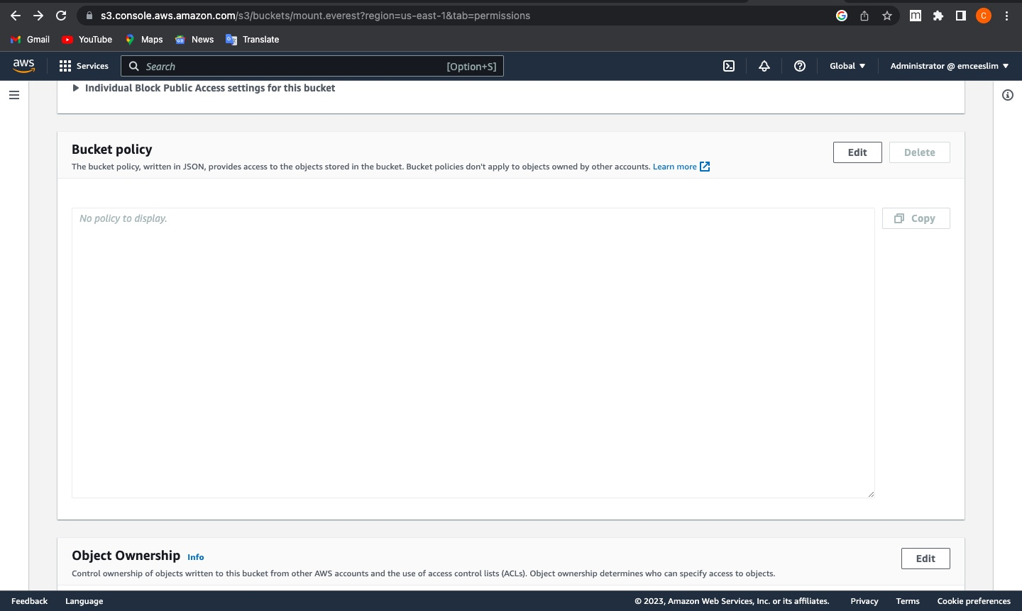
Generating Bucket Policy

Slide 12
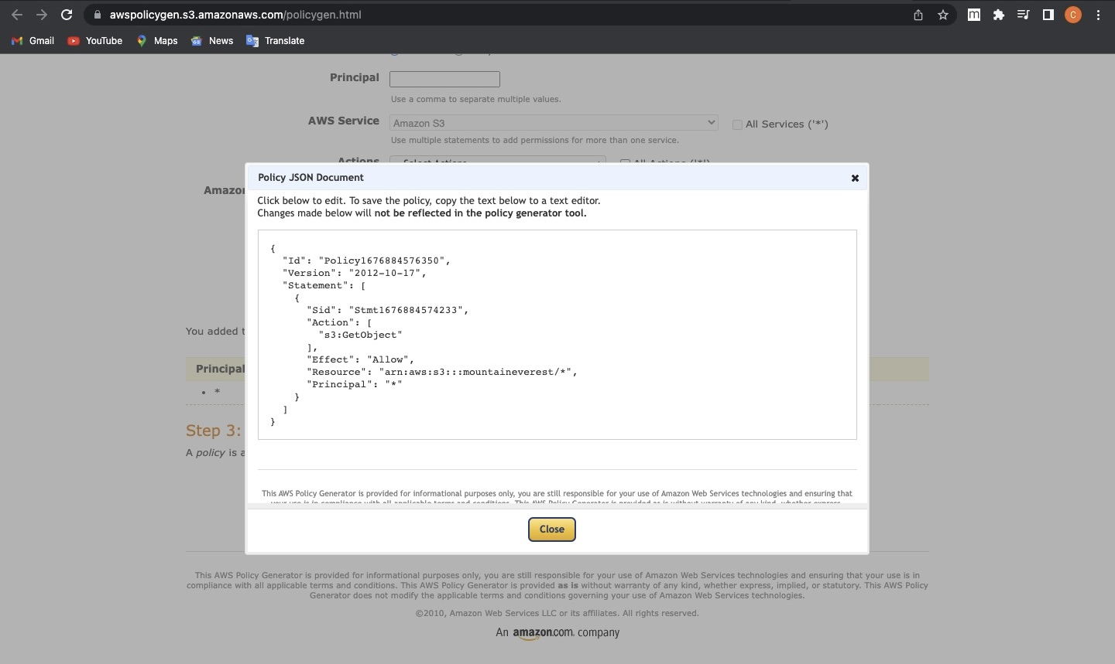
Policy Generation Continuation

Slide 13
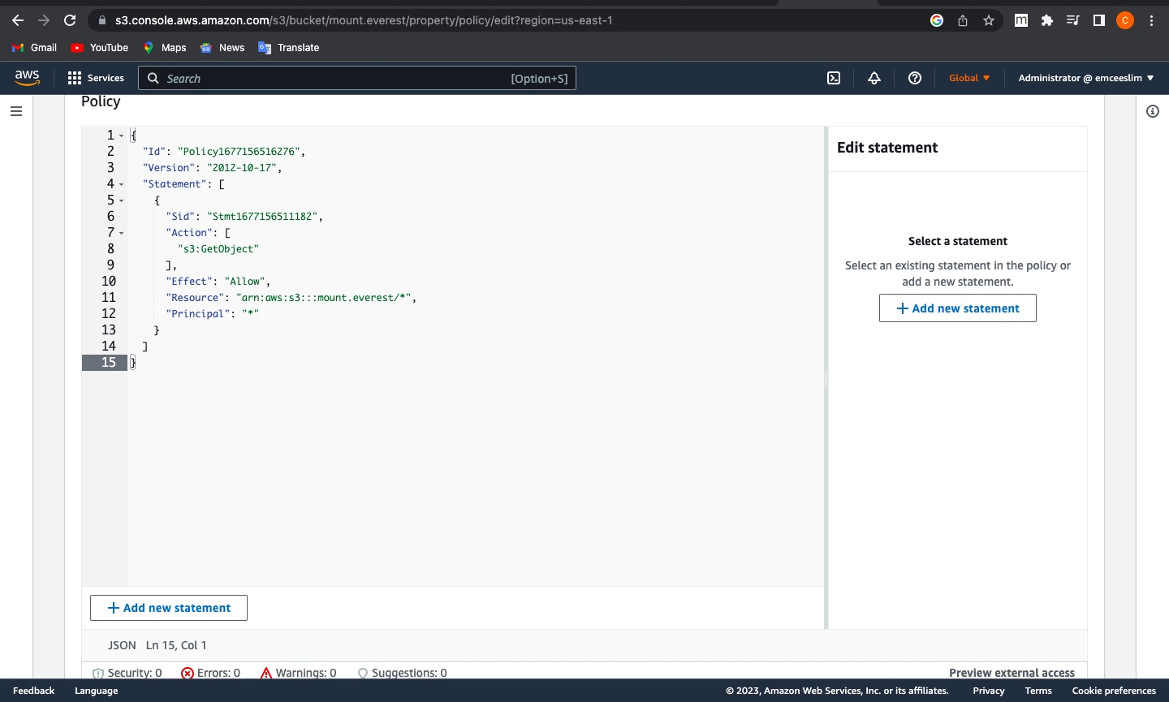
Policy Generation Continuation

Slide 14

Hosting the website externally

Slide 15
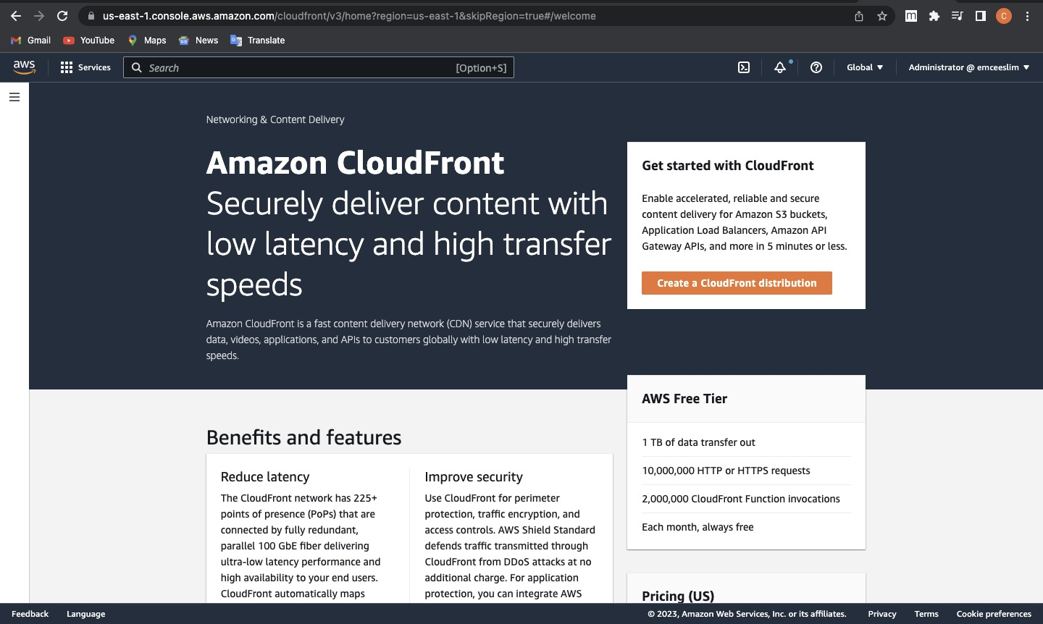
Use of CloudFront to Increase speed and reduce latency

Slide 16
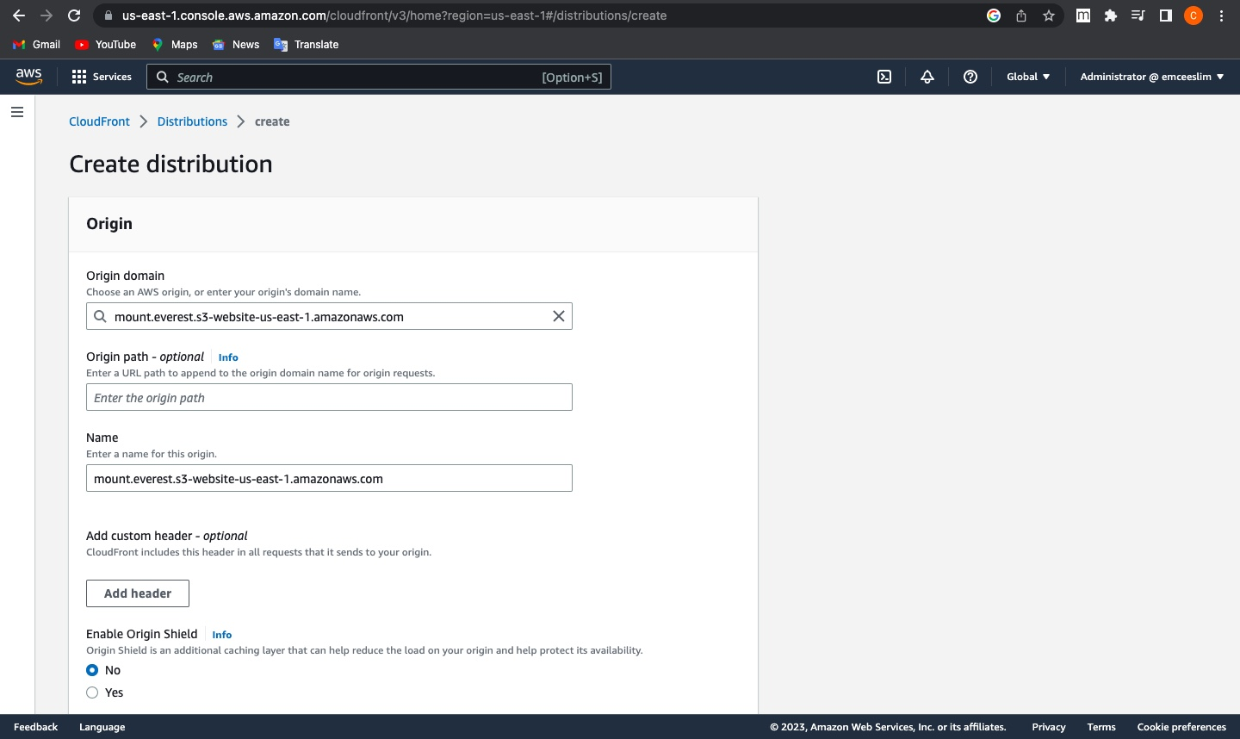
CloudFront Continuation

Slide 17
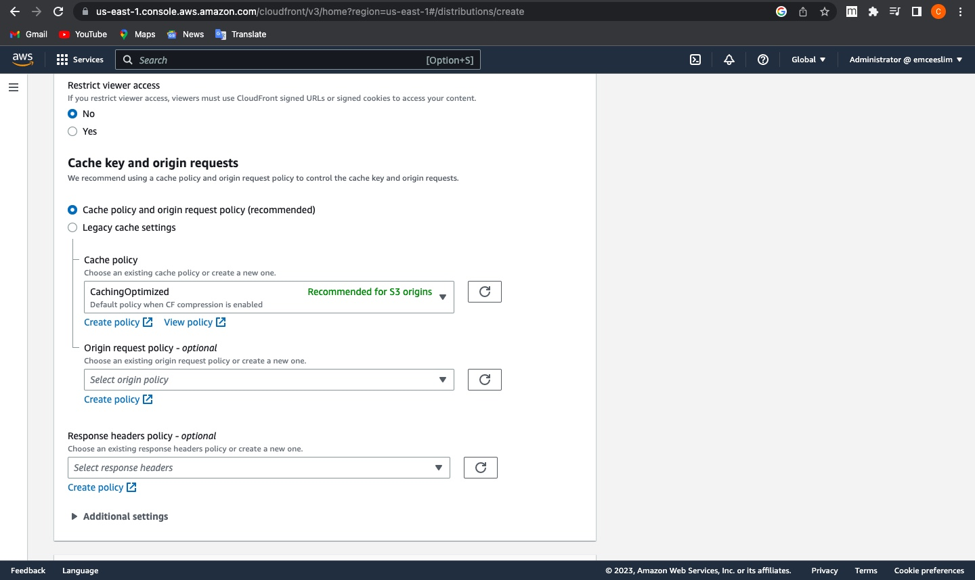
Caching Policy

Slide 18
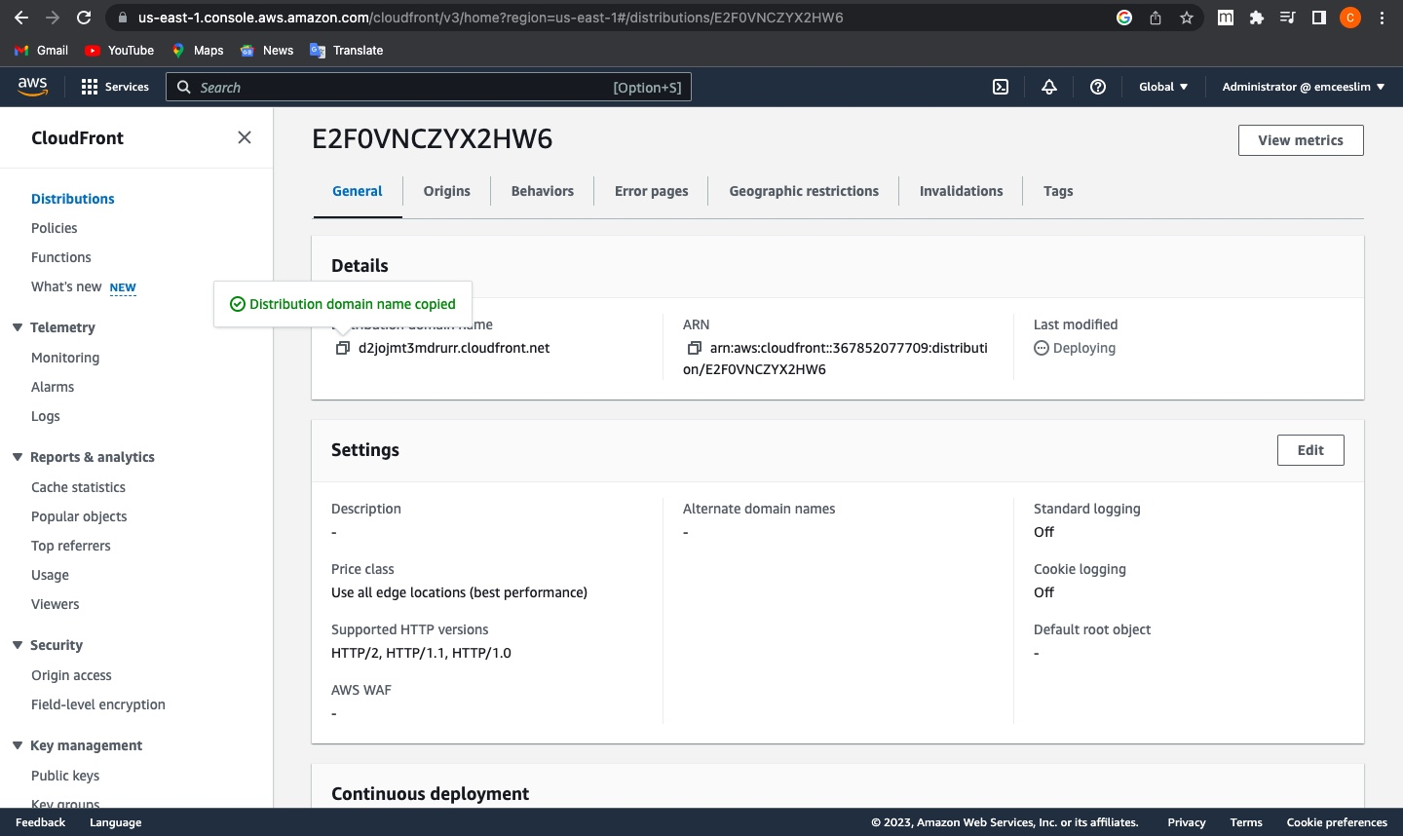
Distribution Domain Creation

Slide 19
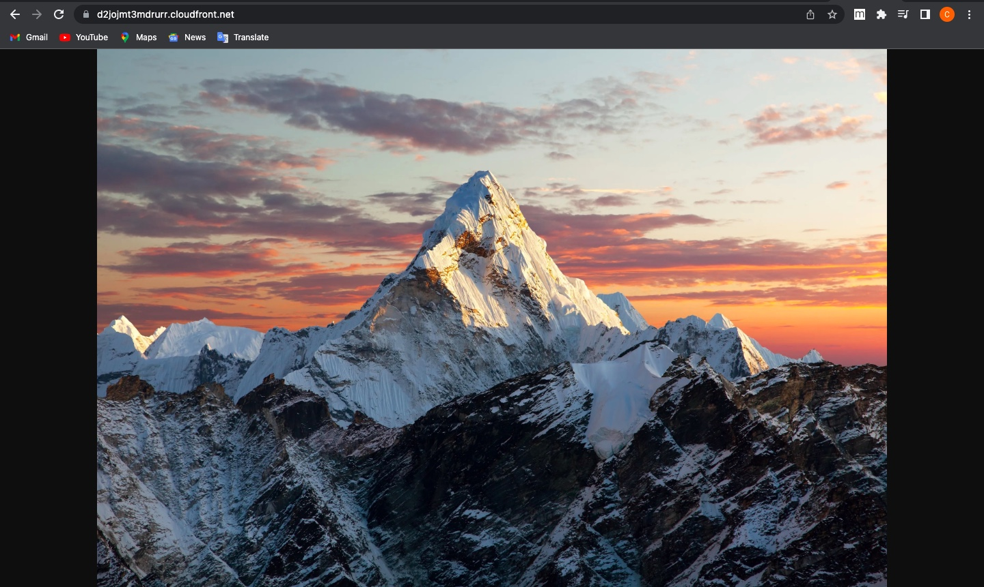
CloudFront Distribution

